Slide 1
WP4 – Knowledge base Design and Implementation
Prof. Dr. Geylani Kardas (KocSistem)

Slide 2
WP4 Knowledge Base Design and Implementation
Design and implement the ModelWriter’s federated Knowledge Base itself, hosting multiple formalisms.
Design and implement its bi-directional text-model synchronization mechanism.
Design and implement its API.
Design and implement a set of specialised modules (plug-ins) that exploit the Knowledge Base in ways that make the tasks of Technical Authors much more productive, e.g. consistency checks.
Design and implement the collaborative functions linking and hierarchically organizing multiple ModelWriter KBs used by different Technical Authors on different sites.

Slide 3
WP4 Knowledge Base Design and Implementation
Plug-in #1 – This provides consistency and completeness checks within the same software lifecycle document, allowing automatic quality review of the content (meaning).
Plug-in #2 – This provides consistency and completeness checks between related set of documents.
Plug-in #3 – This provides semantic comparison between two versions of the same software lifecycle document (i.e. what conceptual changes have happened).

Slide 4
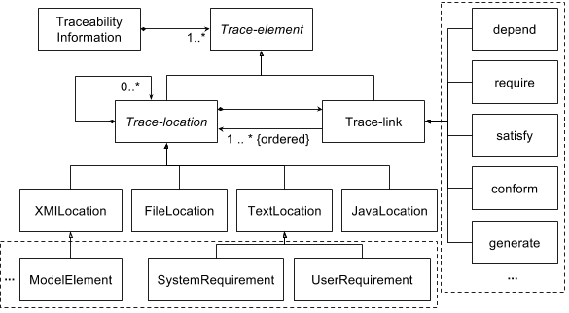
ModelWriter Core Model Approach

Slide 5
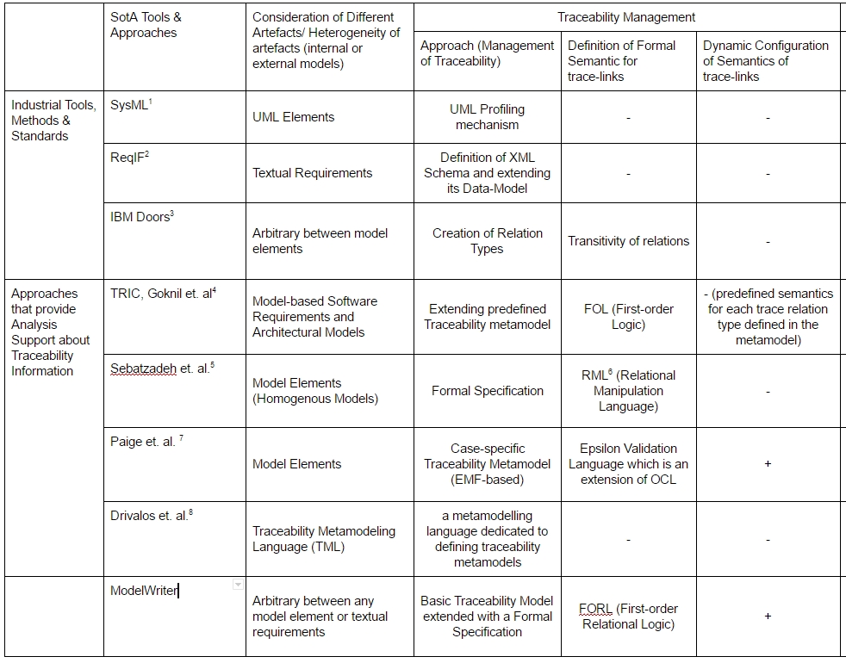
ModelWriter Core Model State-of-the-art

Slide 6
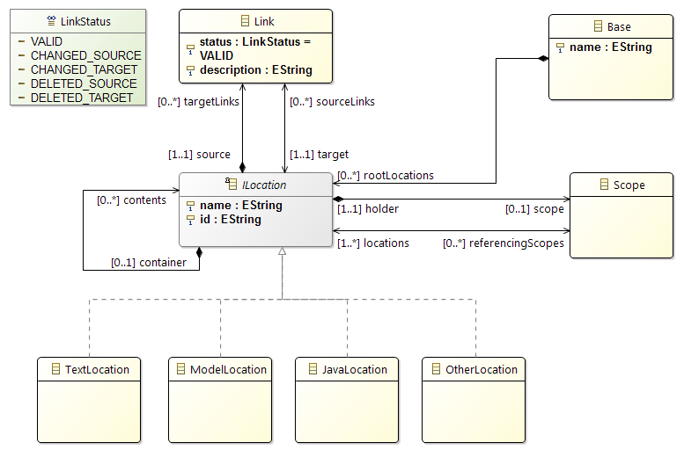
ModelWriter Core Model Implemented by OBEO

Slide 7
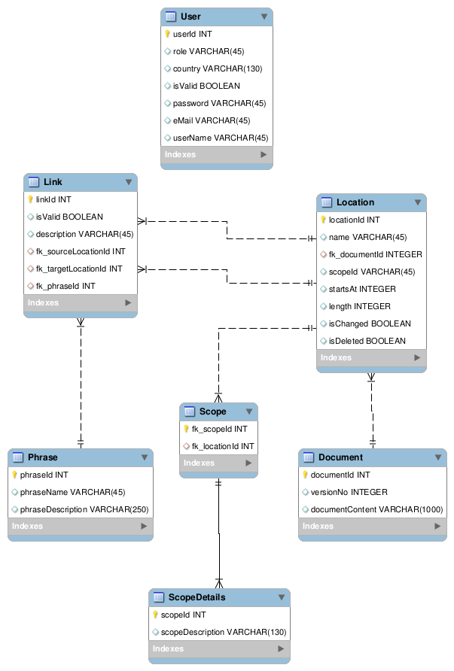
Knowledge-base Design

Slide 8
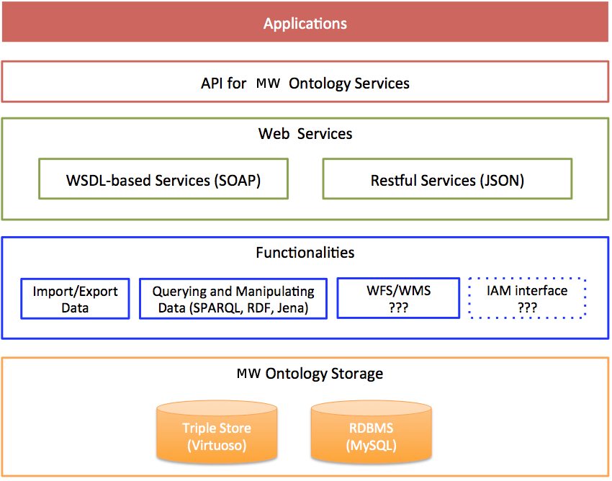
Ontology Infrastructure Knowledge-base Implementation Ontology Infrastructure

Slide 9

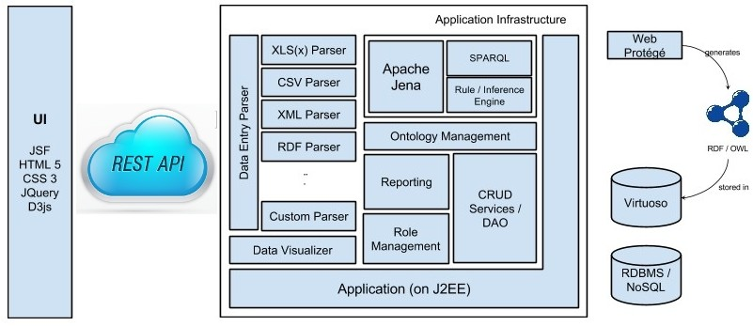




Knowledge-base Implementation Ontology Infrastructure

Slide 10
Ontology Issues and Services
Ontology Issues CRUD operations on ontologies as RESTFUL services Using a sample design document, Mantis designed a document ontology Ontology is hosted on Mantis servers Manual RDF export Automatically RDF export (working on) Ontology Services insertTriple: This method inserts a new triple into an ontology. ImportIntoOntology: This method imports triples into an ontology exportOntology: This method exports a specific ontology executeQuery: This method executes specific query dropOntology: This method drops a specific ontology removeTriple: This method removes specific triple(s)

Slide 11
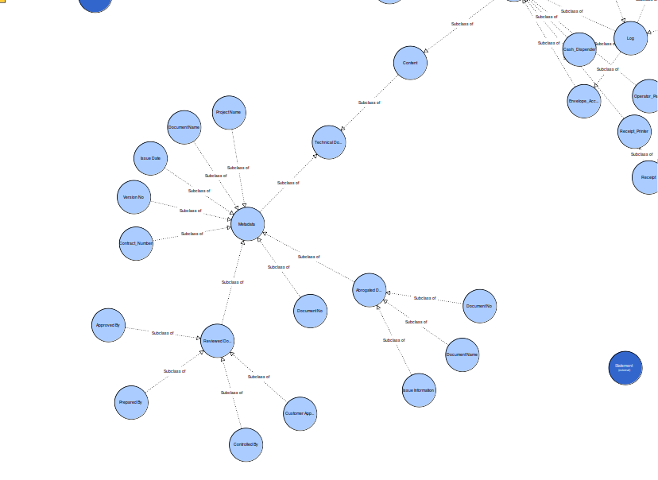
Sample Document Ontology Model

Slide 12
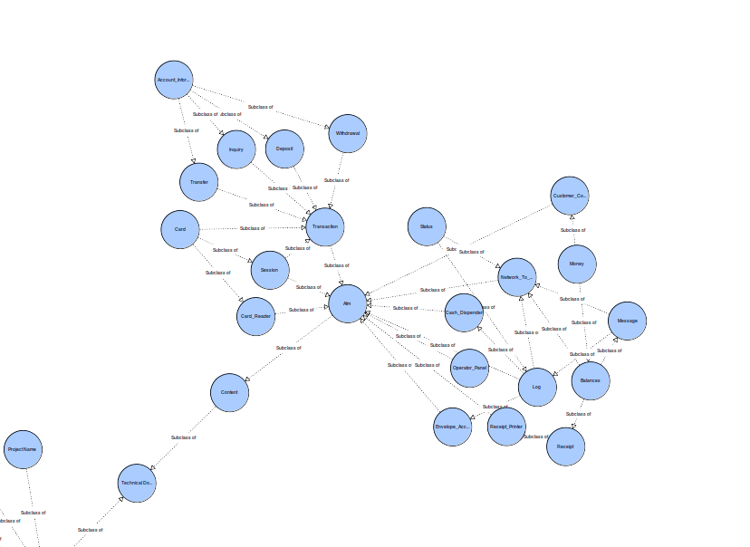
Sample Document Ontology Model Instance

Slide 13
Thank you for your attention We value your opinion and questions.

